Slide 1
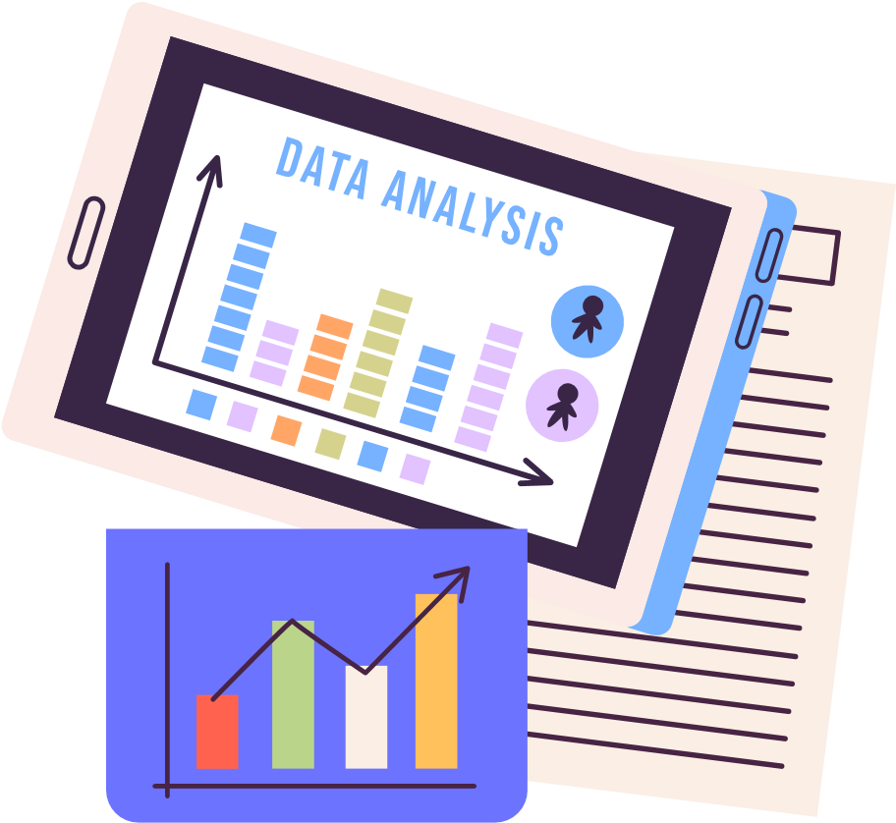



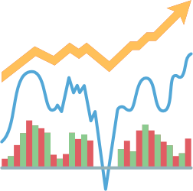

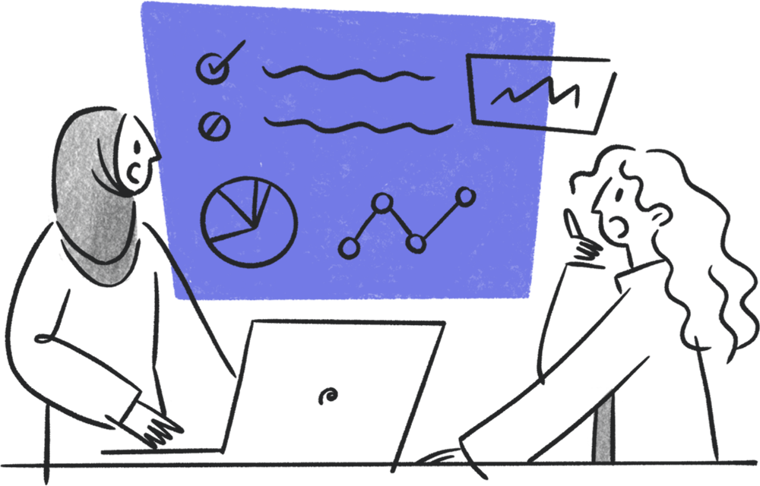

Data Analysis and Visualization with Pandas & Matplotlib: Student Depression Dataset
By:
Sahab Al-Amri
Maryam AL-Aamri

Slide 2




What is the Objective of This Project?
After this lesson, you will be able to:
Analyzing real-world data using Pandas + Matplotlib
Data cleaning + Data exploration
Performing statistical analysis + Graphing
Extracting useful insights

Slide 3

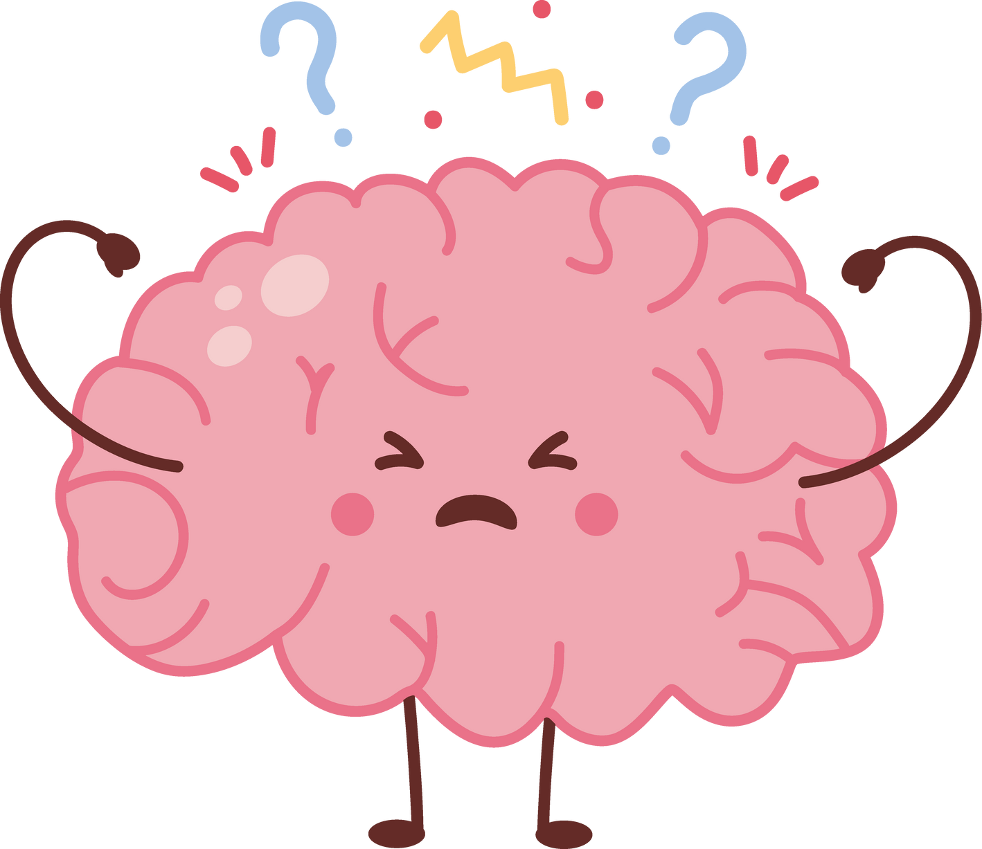
What Happens in the Body and Brain During Depression?
Depression is a mental disorder that causes persistent sadness and loss of interest in life. It results from stress or a chemical imbalance in the brain, affecting sleep, energy, and concentration.

Slide 4


Dataset Description:
Data source: Kaggle
Student Depression Dataset
This dataset compiles a wide range of information aimed at understanding, analyzing, and predicting depression levels among students. It is designed for research in psychology, data science, and education, providing insights into factors that contribute to student mental health challenges and aiding in the design of early intervention strategies.

Slide 5
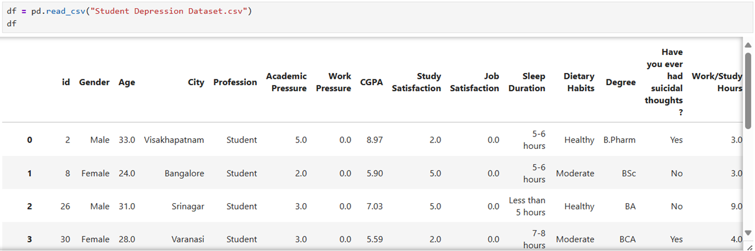
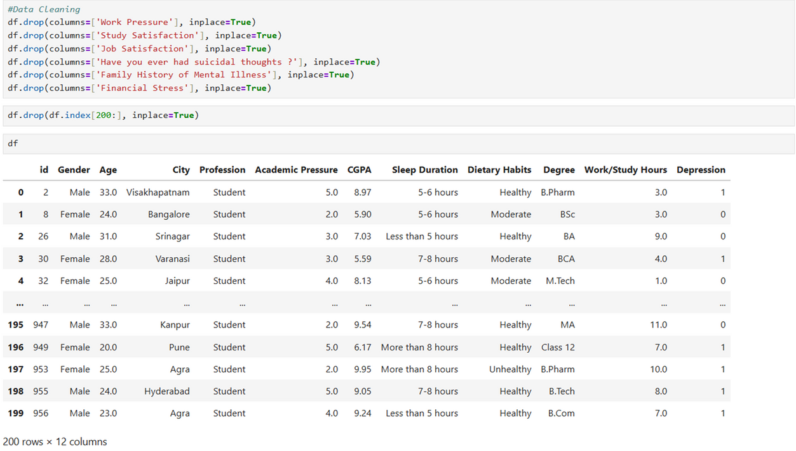
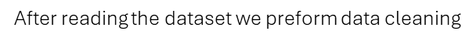
Reading the dataset
Data Cleaning Process

Slide 6
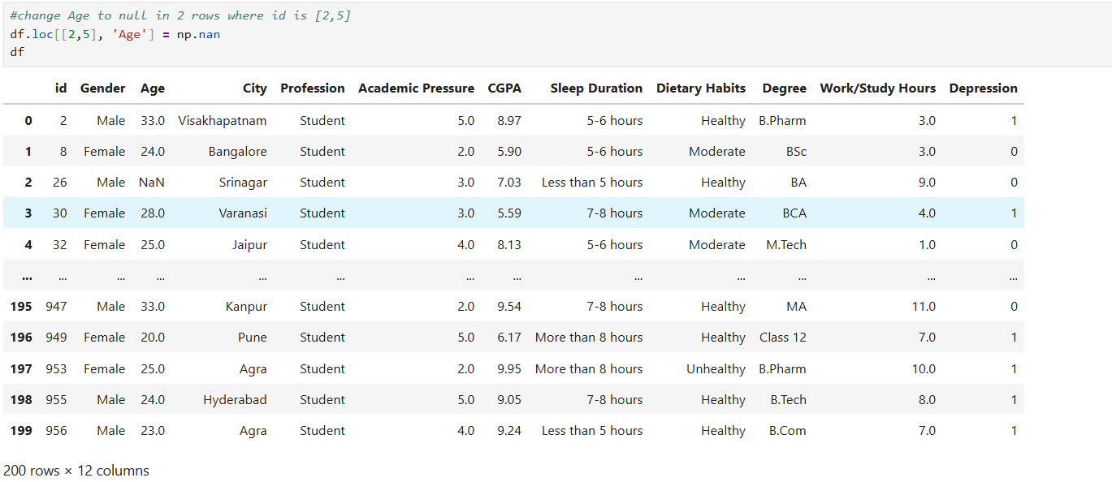
Adding null values to age columns

Slide 7

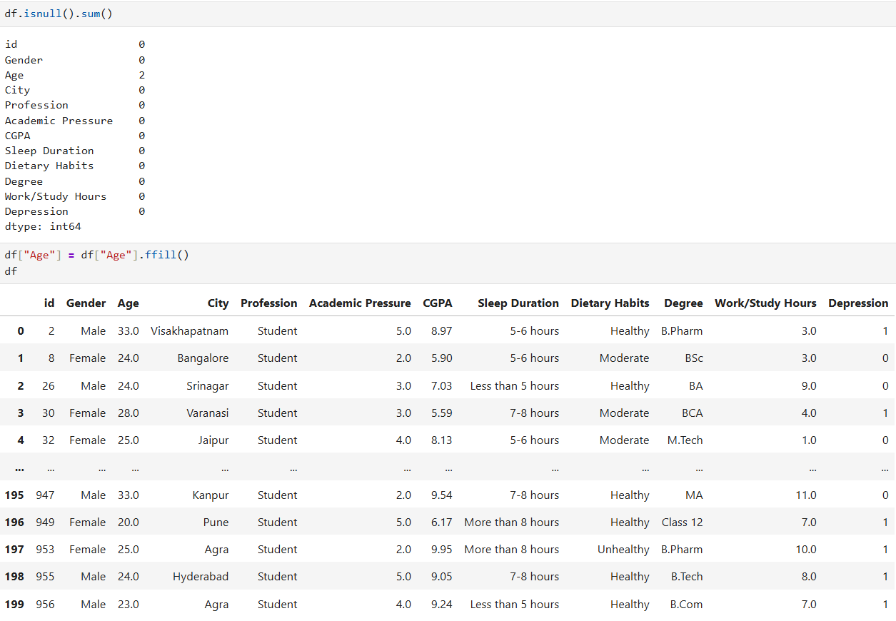
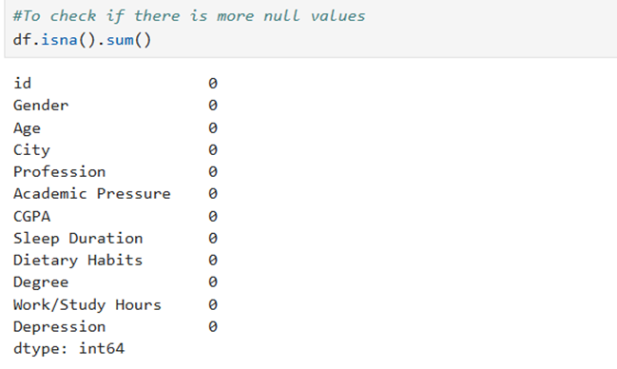
Check if there are null values then fill the missing values with forward fill
Check if there is any left null values

Slide 8
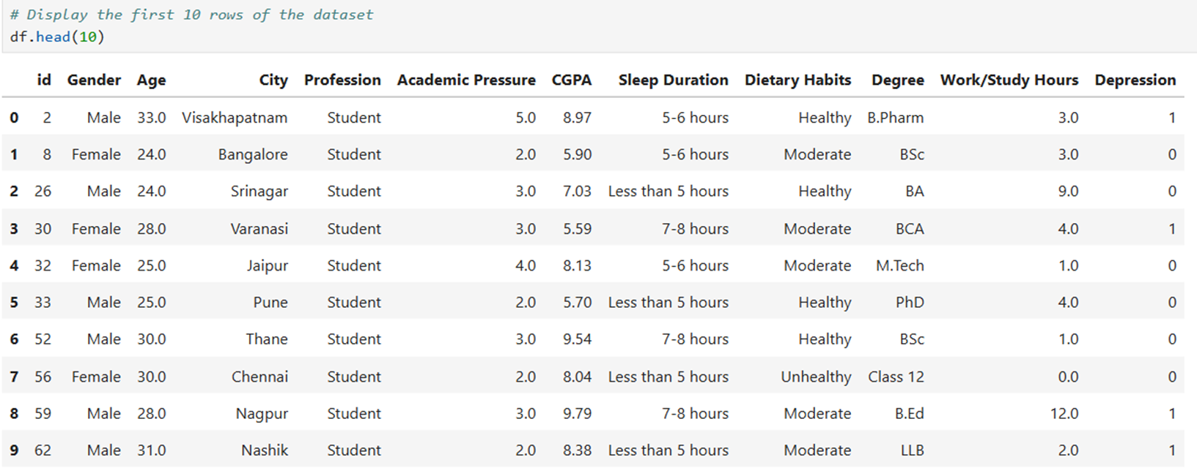
Initial Data Exploration
To display first 10 rows of the dataset use df.head(10)

Slide 9
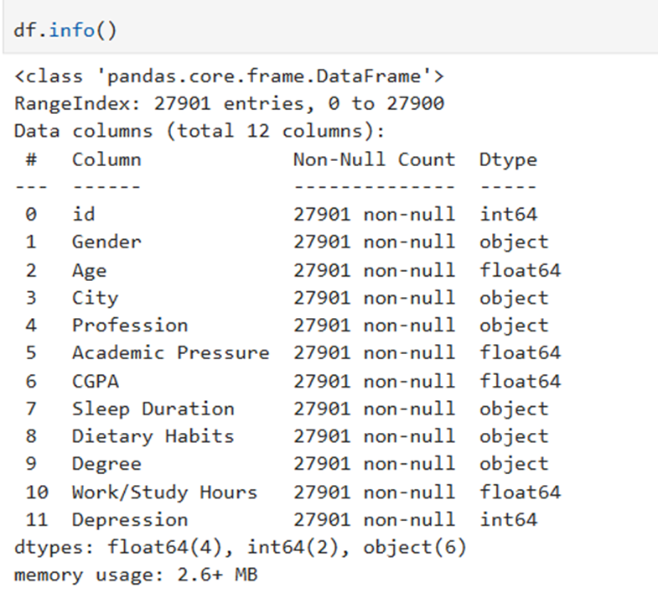
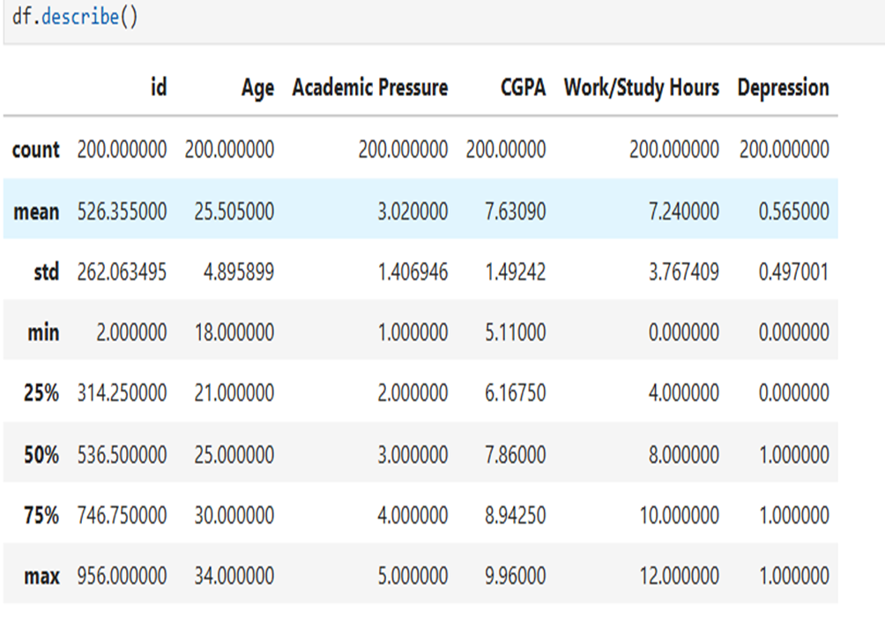

To Show dataset information (.info())
descriptive statistics (.describe() )

Slide 10

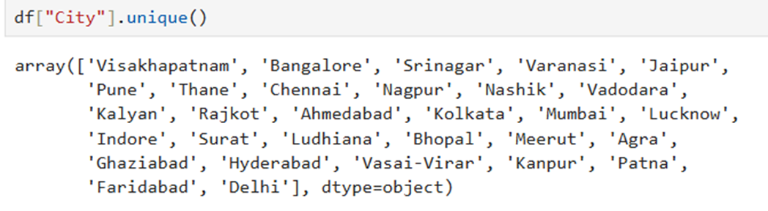
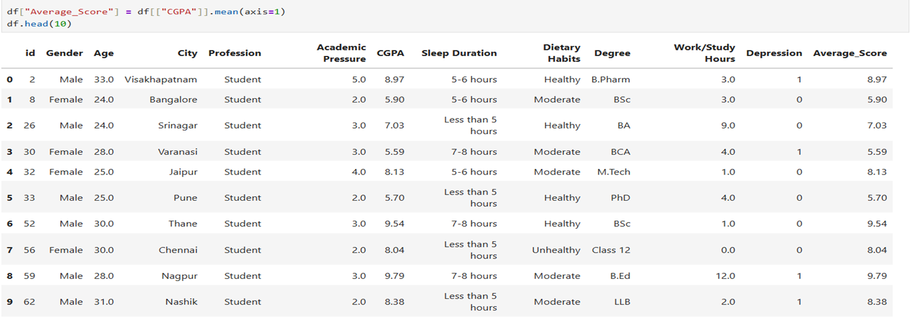
To Count unique values in categorical columns
To calculate the average performance score of each student

Slide 11
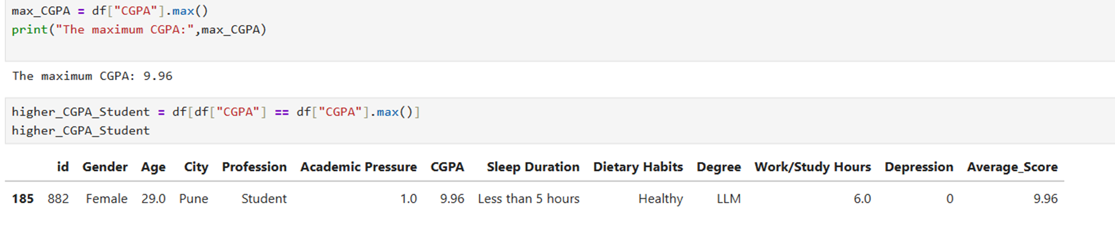
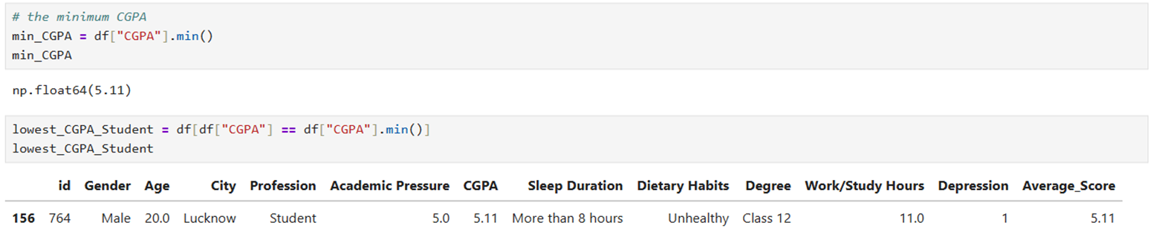
Calculate the maximum CGPA and the student that has the highest CGPA
Calculate the minimum CGPA and the student that has the lowest CGPA

Slide 12
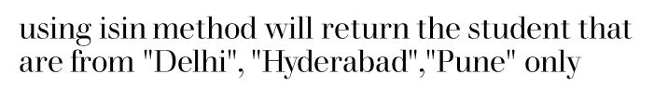
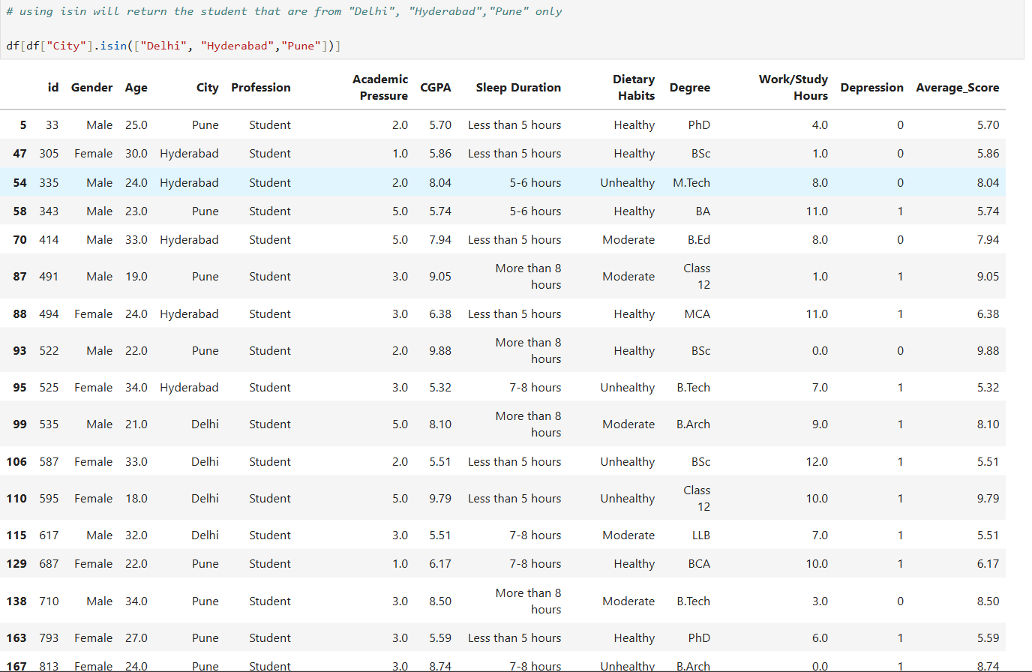
Filter rows using conditions (.loc[], .isin(), .between())

Slide 13
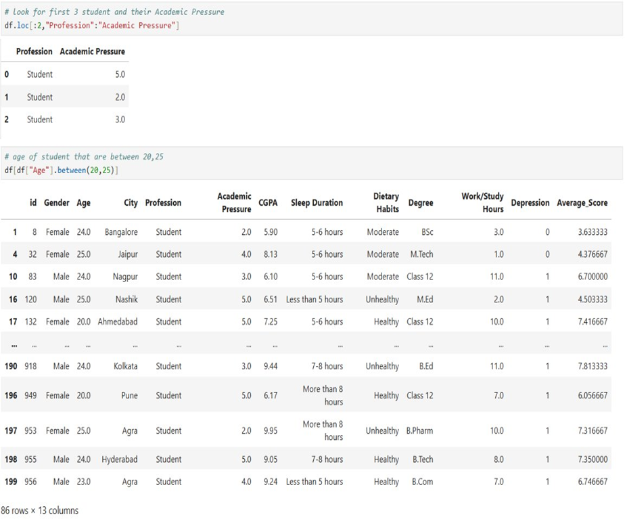
using .loc[] method for look for first 3 student and their Academic Pressure .And
using .between() method for return the student age that are between 20, 25

Slide 14
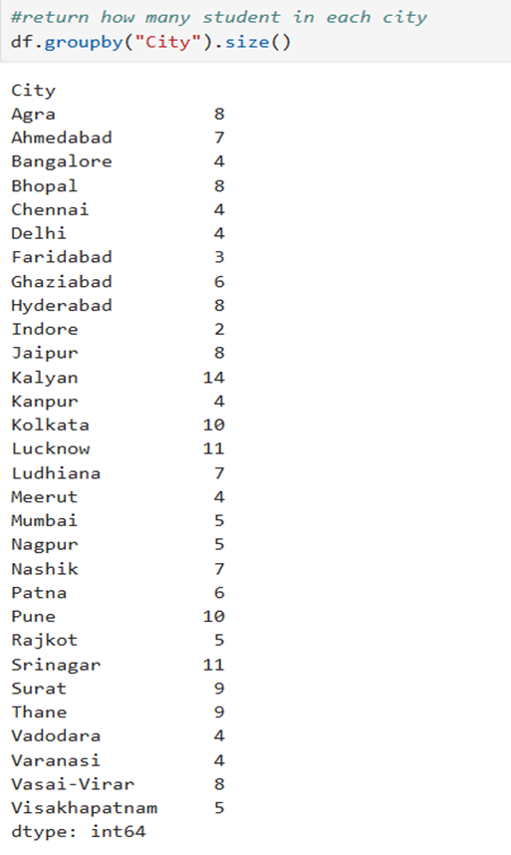
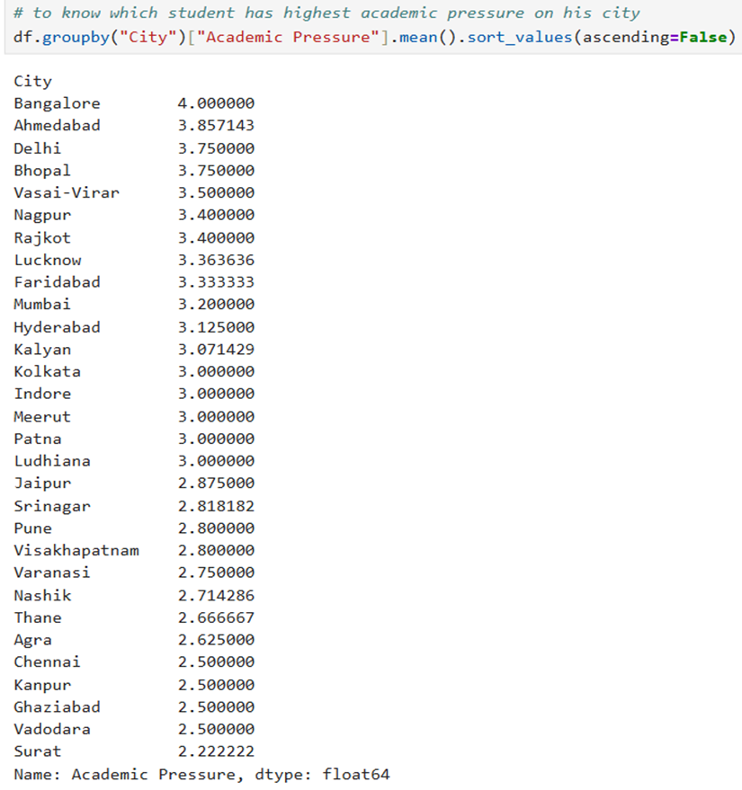
Group data by a category and calculate aggregated statistics

Slide 15
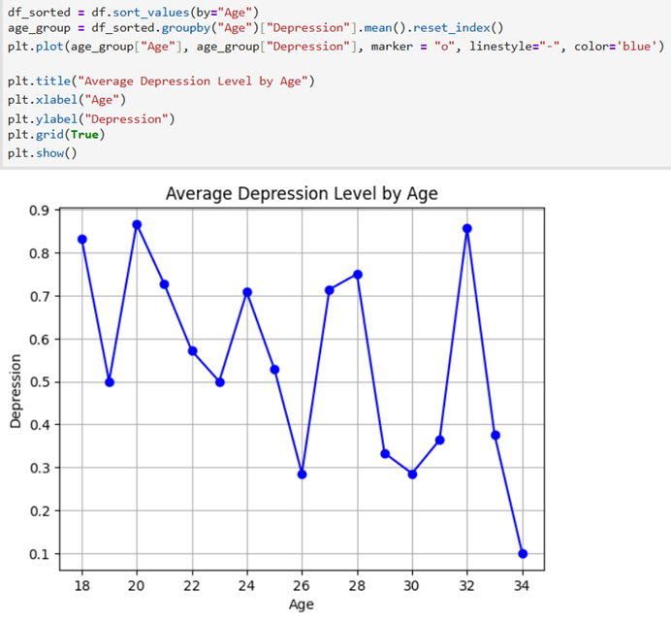
Perform data visualization using matplotlib
Relationship: Age vs Depression (Line Plot)
Question: Is depression related to age?
Insight:
Depression levels fluctuate across ages
Slight decrease after early 20s → older students show more stability

Slide 16
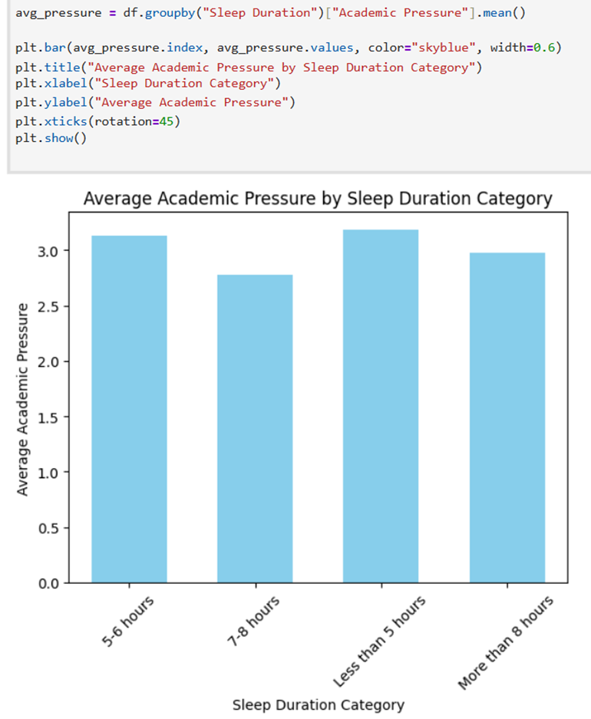
Perform data visualization using matplotlib
Sleep Duration & Academic Pressure (Bar Plot)
Question: How does sleep affect academic pressure?
Insight:
Students sleeping <5 hours or 5–6 hours → highest pressure
Students sleeping 7–8 hours → lowest academic pressure

Slide 17
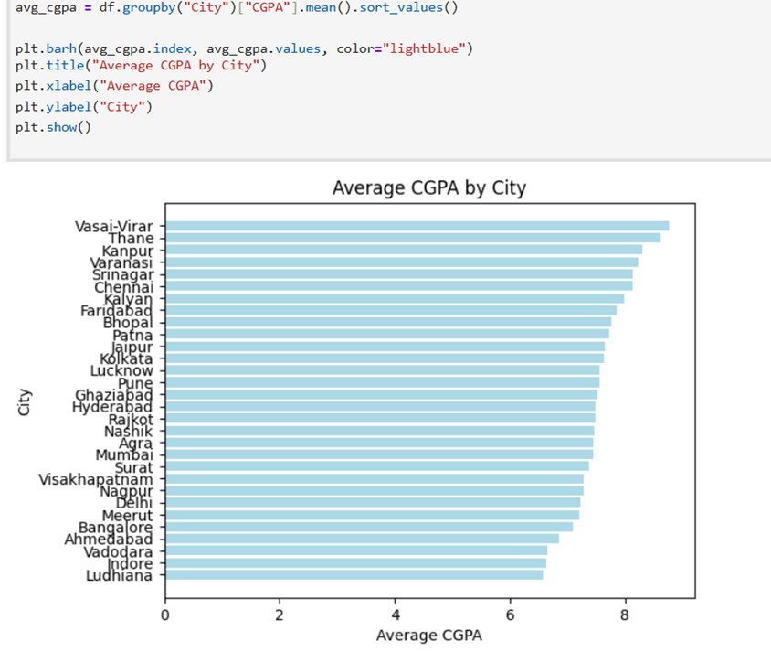
Perform data visualization using matplotlib
Academic Performance by City (Horizontal Bar Plot)
Insight:
Highest CGPA: Vasai-Virar, Thane, Kanpur
Lowest CGPA: Indore, Vadodara, Ludhiana

Slide 18
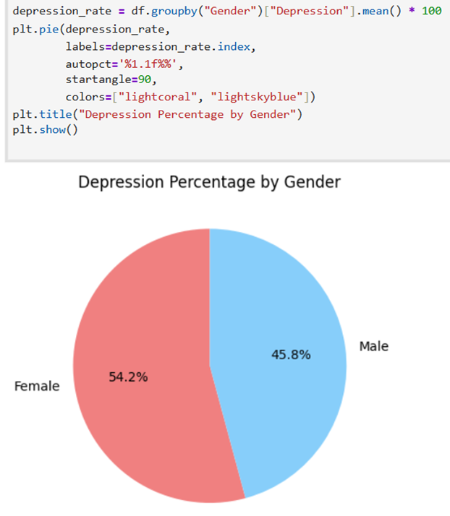
Perform data visualization using matplotlib
Depression by Gender (Pie Chart)
Insight:
Female: 54.2%
Male: 45.8% → Slightly higher depression among female students

Slide 19
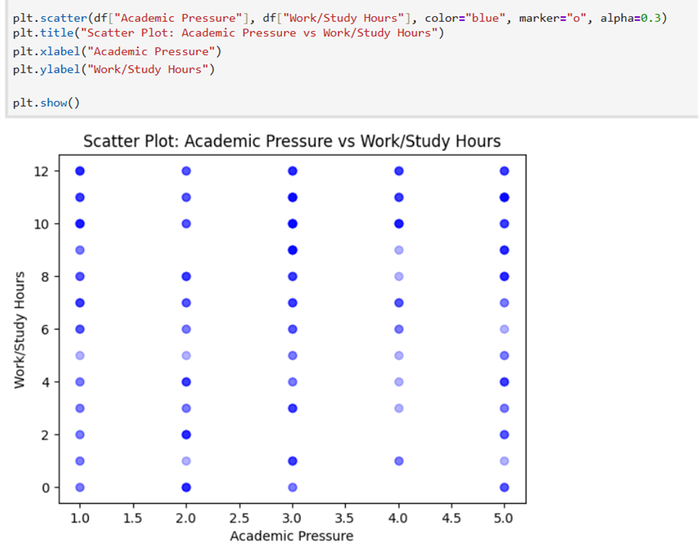
Perform data visualization using matplotlib
Academic Pressure & Study Hours (Scatter Plot)
Insight:
Longer study/work hours → higher academic pressure
Suggests that workload difficulty, not just time, affects stress

Slide 20
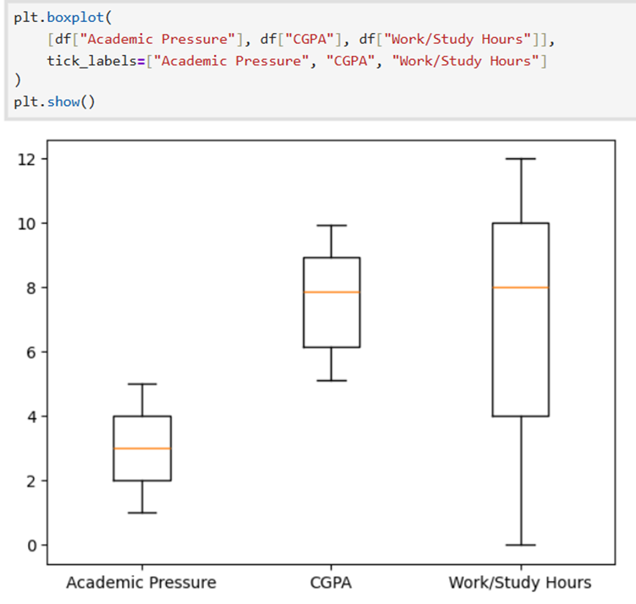
Perform data visualization using matplotlib
Variability in Factors (Box Plot)
Insight:
Work/Study Hours → highest variability
Academic Pressure → lowest median
CGPA → relatively stable across students

Slide 21
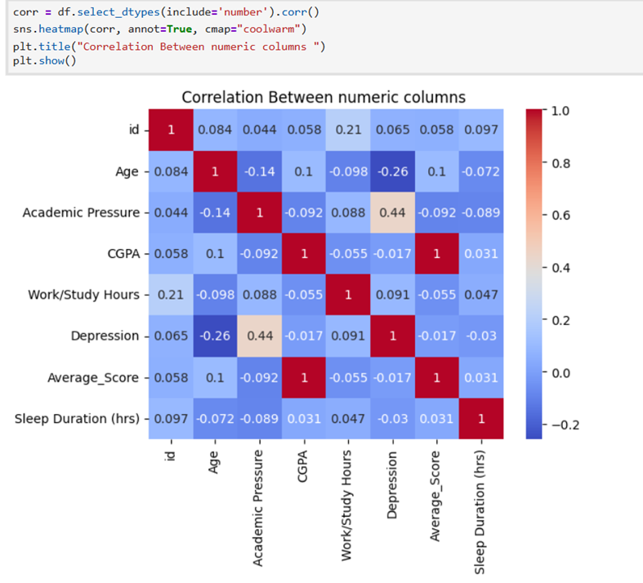
Perform data visualization using matplotlib
Correlation Heatmap
Key Correlations:
Depression ↑ when Academic Pressure ↑
Depression ↓ as Age ↑ → Younger students with high stress are more vulnerable

Slide 22
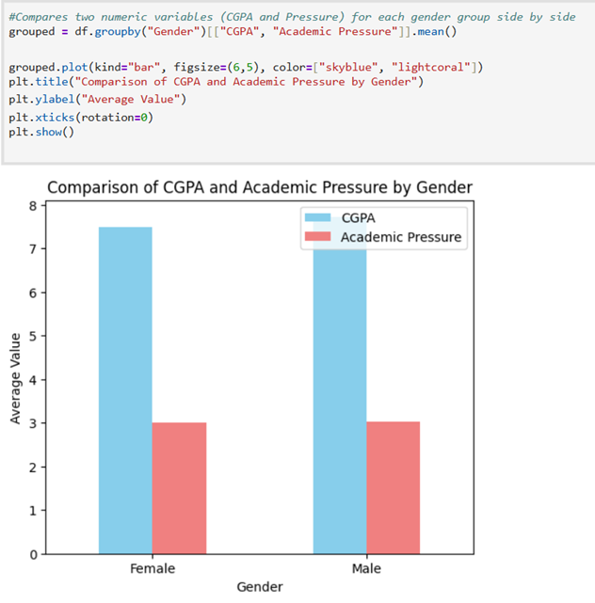
Advanced tasks (challenge)
Gender Comparison: CGPA vs Academic Pressure
Insight:
Academic pressure similar for males & females (~3)
Females slightly outperform in CGPA → Stress affects both genders equally, but females maintain better grades
form marginally better academically.

Slide 23
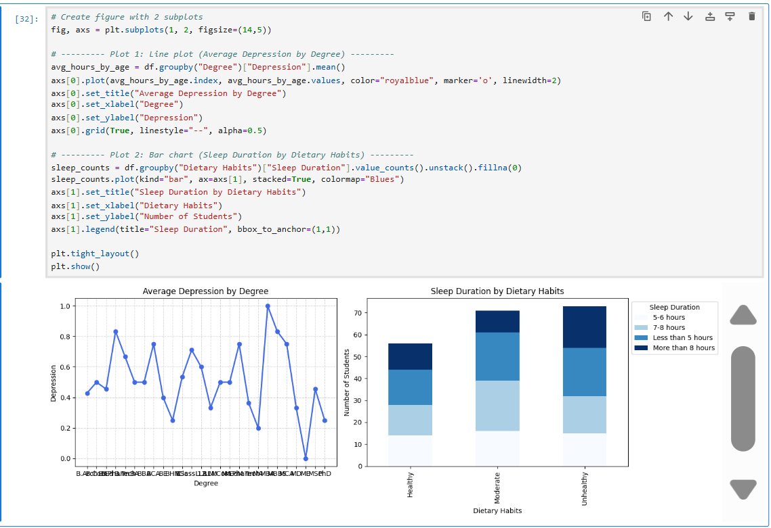
Advanced tasks (challenge)
Combine multiple plots in one figure
Insights:
Depression levels vary by degree (MBA, MPhil higher)
Healthy diet → longer, better sleep
Unhealthy diet → poor or irregular sleep patterns

Slide 24
Insights Story:
After analyzing the student depression dataset, I found several interesting patterns. Female students showed slightly higher depression levels (54.2%) than males (45.8%). Younger students were more likely to feel depressed, especially when academic pressure was high. The data also showed that longer study hours did not always mean higher pressure, suggesting that stress is more related to workload difficulty than study time.
Students with healthy diets and regular sleep (6–8 hours) had better mental well-being, while unhealthy diets were linked to poor or irregular sleep. CGPA remained mostly stable for all students, showing that good performance does not always mean better mental health. Work and study hours peaked around age 26, then gradually decreased with age.
Overall, the study shows that academic pressure, poor sleep, and unhealthy habits increase depression, while a balanced lifestyle and proper rest can improve students’ mental health and academic balance.

Slide 25
Thanks for listening!
The End!

